Slide 2
Course Inventory Management
(CIM)
Training
KimMarie Markel
Kristen Mruk

Slide 3
How to Access
Course Proposals
Nextcatalog.buffalostate.edu/courseadmin
Use your Buffalo State credentials to log in
Program Proposals
Have a different URL (please reach out to KimMarie Markel to initiate)
Use your Buffalo State credentials to log in
These links will appear on the College Senate Curriculum Committee website.

Slide 4
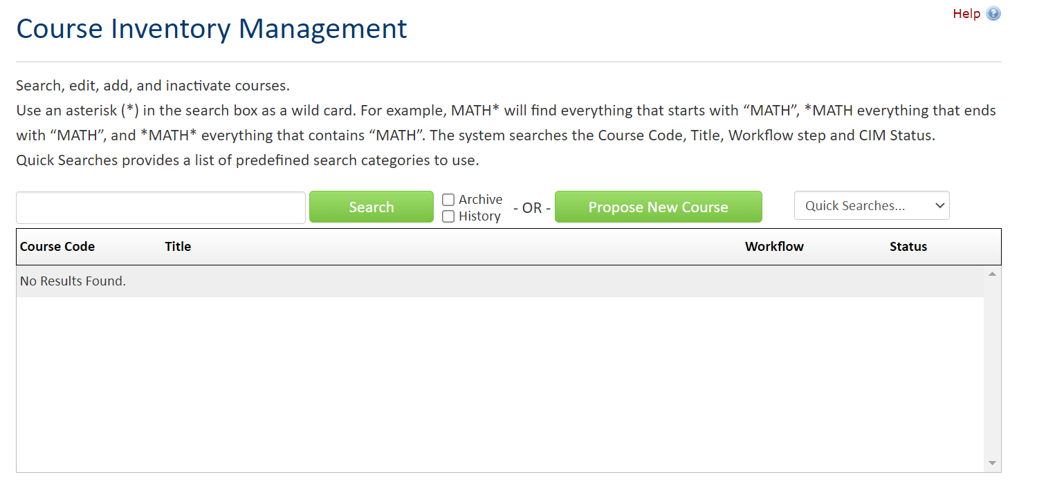
Course Proposal

Slide 5
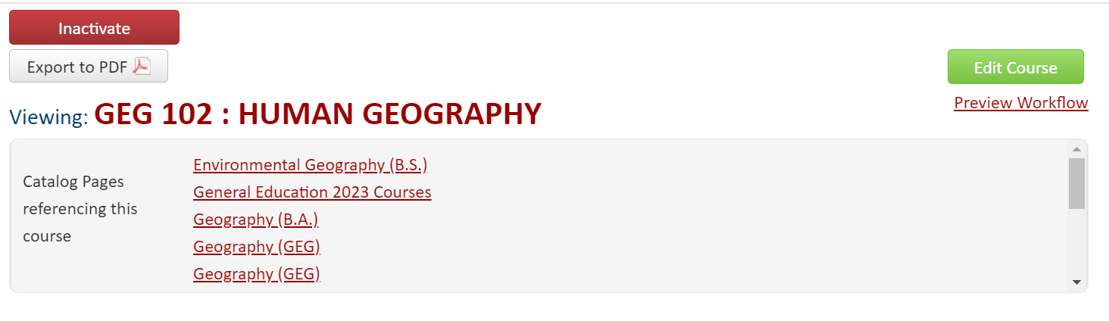

Slide 6
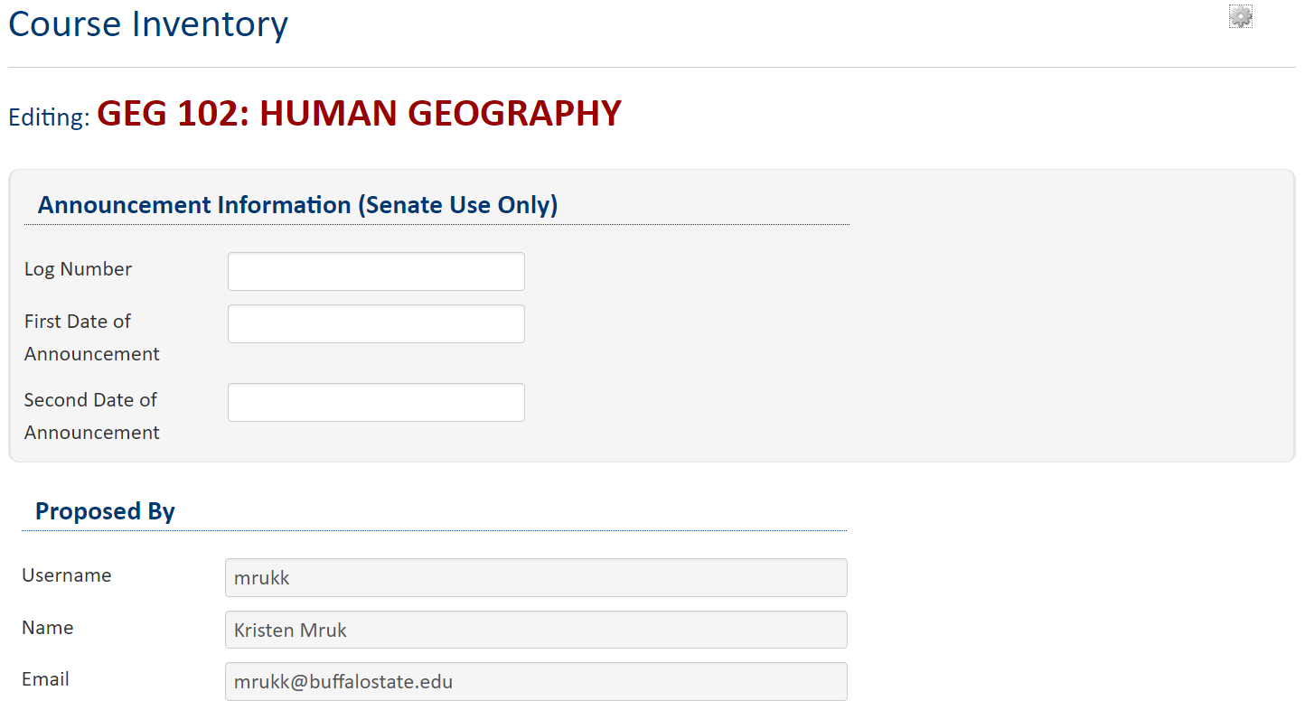
Edit Course

Slide 7
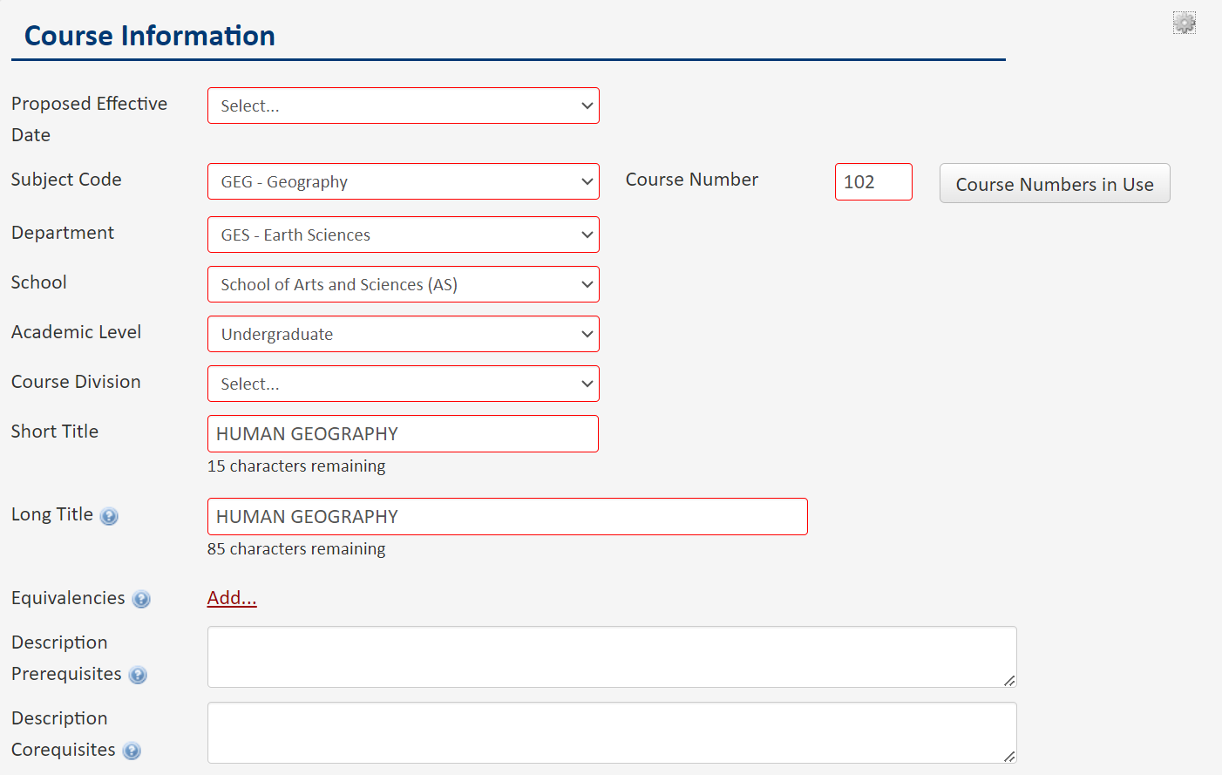
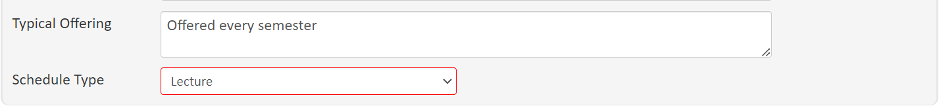
Edit Course

Slide 8
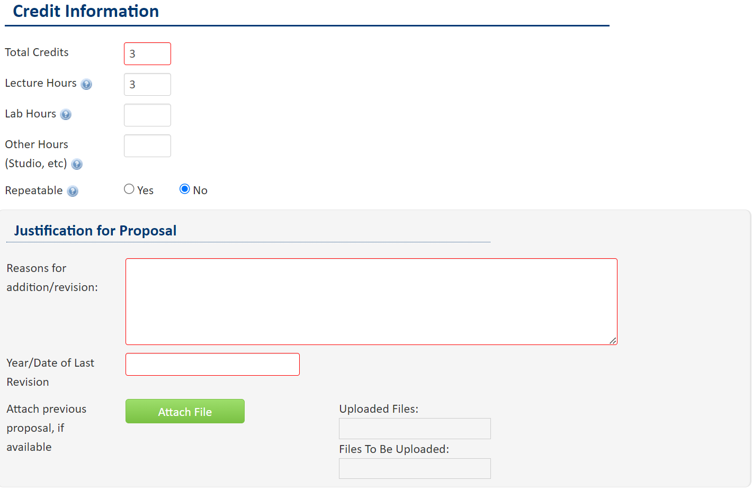

Slide 9
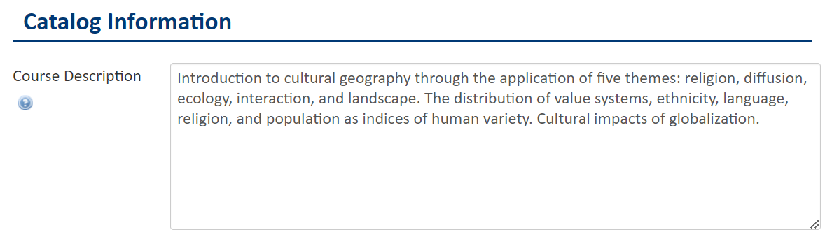
The description should be approximately 50 words. Use sentence fragments when possible, as long as the statement concisely and clearly conveys the key concepts of the course so as to assist general readers in understanding course content. Campus guidelines for catalog preparation will be followed.

Slide 10
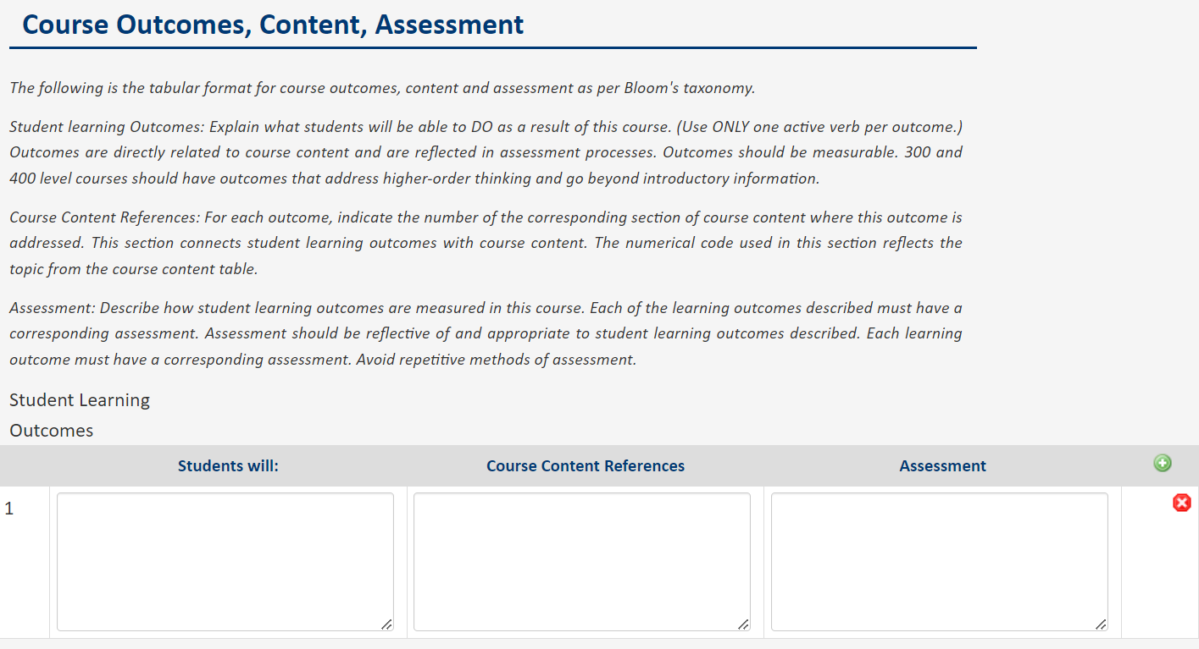

Slide 11
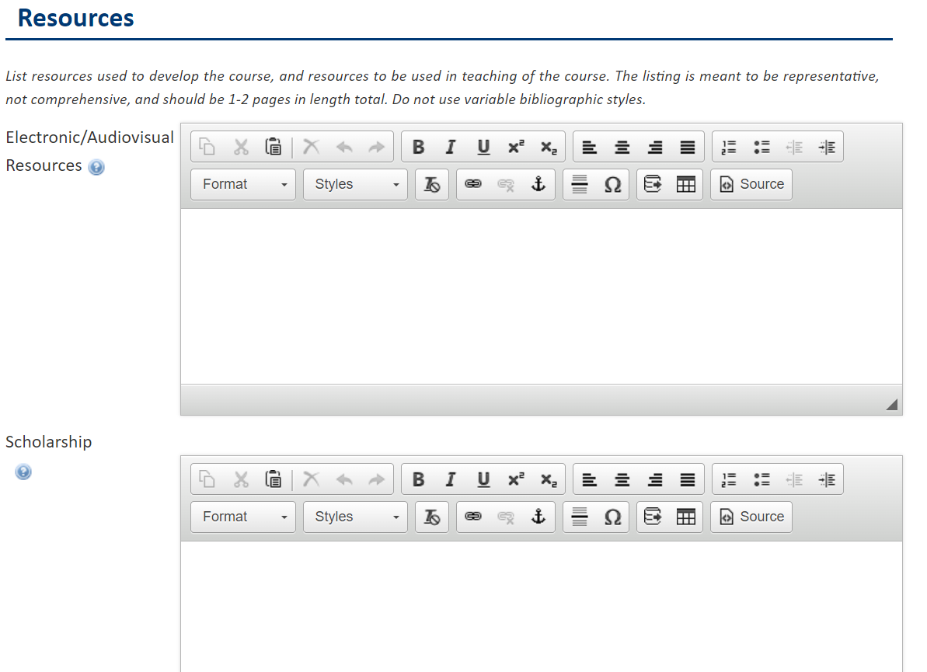

Slide 12
